Slide 1
Please Use Async Await Multithreading and Asynchronous Operations in ASP.NET Core
Kenny Pflug

Slide 2
What Do We Talk About?
How fat are threads?
Why should I let them swim in a pool?
How can I make the pool spill over?
How can I prevent the flood by awaiting tasks?
How does this async-await-stuff even work internally?
How should I structure my ASP.NET Core apps so that they run fluently?

Slide 3

Who is This Guy?
Kenny Pflug
Senior Software Developer at Synnotech AG
PhD Candidate at University of Regensburg
Author of Light.GuardClauses
Organizer of the .NET User Group Regensburg
Blog: www.feo2x.com
Twitter: @feO2x
YouTube: www.youtube.com/c/kennypflug

Slide 4
Let’s Talk About Threads

Slide 5
Some Thread Properties
Originally designed for robustness
Memory Impact
1MB (x86) or 4MB (x64) User Mode Stack
12KB (x86)14 KB (x64) Kernel Mode Object
Context Switching
Lx Cache Misses

Slide 6
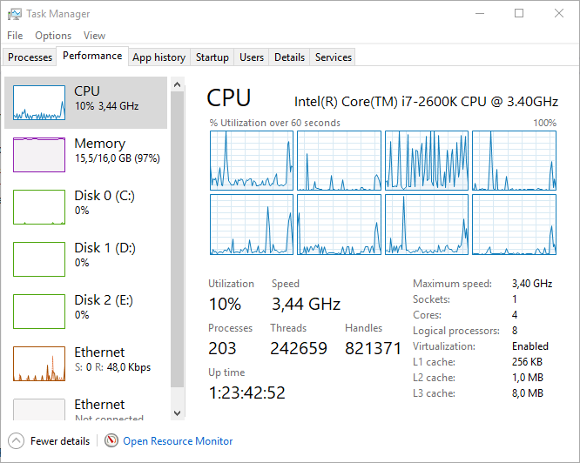
How Many Threads Can You Allocate in .NET Core?
on x64: about 250,000 on 16GB RAM
on x86: about 1,000

Slide 7
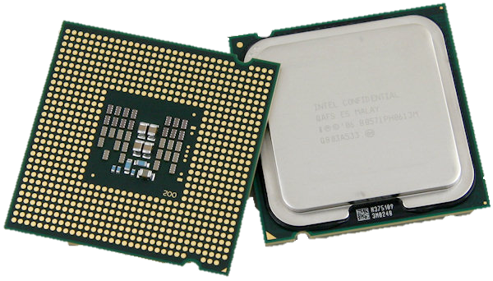
How Many Threads Should You Have Per Process?
Depends on the number of cores in your target system
Ideally, you have one thread per core
The Thread Pool manages an optimal number of threads for you

Slide 8
Swimming in the Thread Pool

Slide 9

The Thread Pool
The Thread Pool keeps a certain amount of Background Threads alive
This amount is dynamically increased or decreased depending on the work that is handed over
Work can be handed over e.g. via ThreadPool.QueueUserWorkItem or Task.Start

Slide 10
When Does The Thread Pool Spill Over?
When we block its threads.

Slide 11
Here’s The Problem: Synchronous I/O Blocks Threads

Slide 12

Synchronous I/O Access
FileStream
Windows I/O Dispatcher
NTFS Driver

Slide 13
Synchronous I/O Access
IRP
FileStream
Windows I/O Dispatcher
NTFS Driver

Slide 14
Synchronous I/O Access
IRP
FileStream
Windows I/O Dispatcher
NTFS Driver

Slide 15
Synchronous I/O Access
IRP
FileStream
Windows I/O Dispatcher
NTFS Driver

Slide 16
Synchronous I/O Access
IRP
Hardware I/O
Thread Blocks
FileStream
Windows I/O Dispatcher
NTFS Driver

Slide 17
Synchronous I/O Access
IRP
FileStream
Windows I/O Dispatcher
NTFS Driver

Slide 18
Synchronous I/O Access
IRP
FileStream
Windows I/O Dispatcher
NTFS Driver

Slide 19
Synchronous I/O Access
IRP
FileStream
Windows I/O Dispatcher
NTFS Driver

Slide 20
Asynchronous I/O Access
IRP
Hardware I/O
FileStream
Windows I/O Dispatcher
NTFS Driver

Slide 21
Asynchronous I/O Access
IRP
Hardware I/O
FileStream
Windows I/O Dispatcher
NTFS Driver

Slide 22
Asynchronous I/O Access
IRP
Hardware I/O
FileStream
Windows I/O Dispatcher
NTFS Driver

Slide 23
Asynchronous I/O Access
IRP
FileStream
Windows I/O Dispatcher
NTFS Driver
Queued in the Thread Pool
(not necessarily the thread you started from)

Slide 24
Asynchronous I/O Access
IRP
FileStream
Windows I/O Dispatcher
NTFS Driver

Slide 25
Asynchronous I/O…
…returns to the caller while the third-party system (DB, Web Service, File System, etc.) is handling your request
In Client Applications, this usually results in continuous rendering of the UI Thread (the UI does not freeze)
In Web Apps, this results in the thread being able to handle another request

Slide 26
Use Async Await
It is by far the easiest API to handle asynchronous programming.

Slide 27
But How Does Async Await Actually Work Under The Covers?
It creates a state machine that jumps to the “right spot” (the next statement after await) when an asynchronous operation finishes.

Slide 28
The Pros of Async Await
It looks like synchronous code, but executes asynchronously
No more need for continuation methods, logic that belongs together can stay in one function
Ties in with the existing Task Parallel Library (TPL)
The VS Debugger lets you step over asynchronous functions as if they were synchronous

Slide 29
The Cons of Async Await
The Flow-Of-Control is altered – methods can return when an await statement is executed
Async Await has a drastic impact on our Object-Oriented Design

Slide 30
Async Await and O-O Design
Core

Slide 31
Async Await and O-O Design
User Interface
Service Communication
Core
Data Access

Slide 32
Async Await and O-O Design
User Interface
Service Communication
Core
IRepository
Data Access
MongoRepository

Slide 33
Async Await and O-O Design
User Interface
public interface IRepository
{
Contact LoadById(Guid id);
}
Service Communication
Core
IRepository
public class MongoRepository : IRepository
{
public Contact LoadById(Guid id);
}
Data Access
MongoRepository

Slide 34
Async Await and O-O Design
User Interface
public interface IRepository
{
Contact LoadById(Guid id);
}
Service Communication
Core
IRepository
public class MongoRepository : IRepository
{
public Task<Contact> LoadById(Guid id);
}
Data Access
MongoRepository

Slide 35
Async Await and O-O Design
User Interface
public interface IRepository
{
Task<Contact> LoadById(Guid id);
}
Service Communication
Core
IRepository
public class MongoRepository : IRepository
{
public Task<Contact> LoadById(Guid id);
}
Data Access
MongoRepository

Slide 36
Async vs. Sync APIs
An asynchronous API looks different than a synchronous one.
Asynchronous methods can execute synchronously but the other way is not possible.
public async Task DoSomethingAsync() { // Calculate something synchronously here return Task.CompletedTask; }

Slide 37
Please use Async Await when accessing external systems
Your ASP.NET Core Apps will scale way better.

Slide 38
Sources
Jeffrey Richter – Advanced .NET Threading: Part 1 Part 2 Part 3 Part 4 Part 5
Joseph Albahari – Threading in .NET http://www.albahari.com/threading/
Jon Skeet – Asynchronous C# 5.0 Pluralsight Course on Asynchronous C# 5.0

Slide 39
Image Contributions
CPUs: https://namu.wiki/w/CPU
Ball of Wool: Tim Reckmann https://www.flickr.com/photos/foto_db/16252248370

Slide 40
Revisit!
The slides and source code are available at:
https://github.com/feO2x/AdcCore2017.MultithreadingAndAsync

Slide 41
Any Questions?

Slide 42
Thank you!
I‘m looking forward to your feedback!
Kenny Pflug

